Slide 1
Hash Functions Video Lectures Available at https://drive.google.com/drive/folders/1vs9oXRkoNj5XMtsOvKqi_547xvrfxQzl

Slide 2
AGENDA
Introduction to Hash Functions.
Motivation.
Requirements of Hash Function.
Properties.
Attacks on Hash Function.
Collision Attack
Birthday paradox
Pre-Image

Slide 3
Hash Functions
Hash functions are an important cryptographic primitive and are widely used in protocols. They compute a digest of a message which is a short, ﬁxed-length bit-string.
Used in
Signature
MACs
Key derivation
RNGs etc.

Slide 4




RSA Digital Signatures
Alice
$$K_{pr(A)}=(d)$$
$$K_{pub\left(A\right)}=(n,e)$$
$${s= Sig}_{Kpr\left(A\right)}(x)$$
$s$ = $x^{d} mod n$
Bob
$${Verify}_{Kpub(A)}(x,s)$$
$$x^{′}{=s}^{e}mod n$$
$$if x^{′}= = x, true/false$$
$$(n,e)$$
$$(x,s)$$

Slide 5
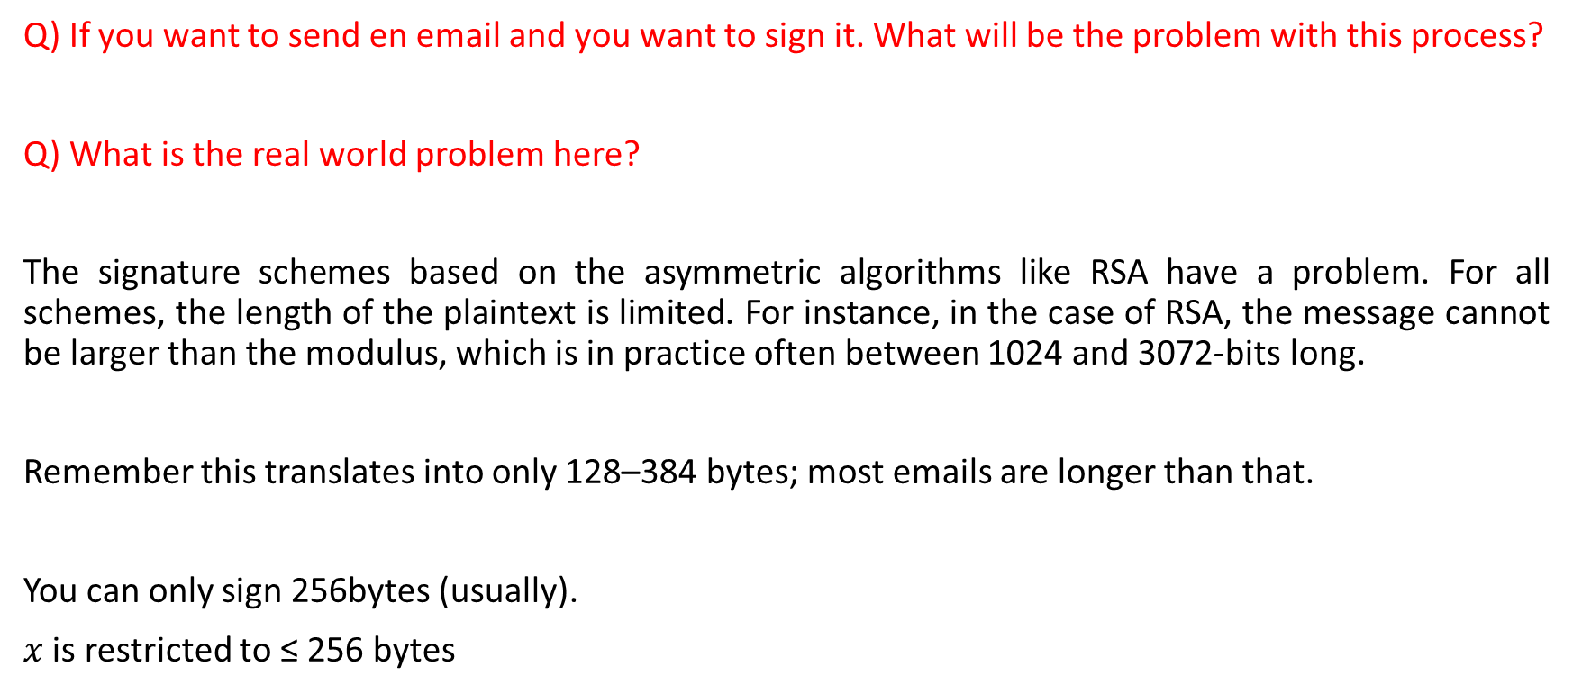
Motivation
Q) If you want to send en email and you want to sign it. What will be the problem with this process?
Q) What is the real world problem here?
The signature schemes based on the asymmetric algorithms like RSA have a problem. For all schemes, the length of the plaintext is limited. For instance, in the case of RSA, the message cannot be larger than the modulus, which is in practice often between 1024 and 3072-bits long.
Remember this translates into only 128–384 bytes; most emails are longer than that.
You can only sign 256bytes (usually).
$x$ is restricted to ≤ 256 bytes

Slide 6
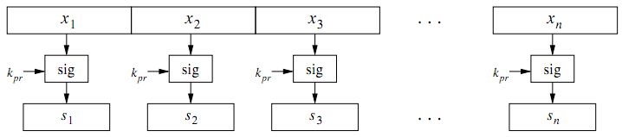
Motivation
Example: If we have a file of 1KB, 256 bytes x 4 will be required.
$$\text{(}\text{x}\text{1}\text{, }\text{s}\text{1}\text{), (}\text{x}\text{2}\text{, }\text{s}\text{2}\text{), (}\text{x}\text{3}\text{, }\text{s}\text{3}\text{) ………(}\text{x}\text{n}\text{, }\text{s}\text{n}\text{)}$$

Slide 7
Issues
What are the problems in this approach?
Problem 1: High Computational Load
Digital signatures are based on computationally intensive asymmetric operations such as modular exponentiations of large integers. Even if a single operation consumes a small amount of time (and energy, which is relevant in mobile applications), the signatures of large messages, e.g., email attachments or multimedia ﬁles, would take too long on current computers.
Furthermore, not only does the signer have to compute the signature, but the veriﬁer also has to spend a similar amount of time and energy to verify the signature.

Slide 8
Issues
What are the problems in this approach?
Problem 2: Message Overhead
Obviously, this naïve approach doubles the message overhead because not only must the message be sent but also the signature, which is of the same length in this case. For instance, a 1-MB ﬁle must yield an RSA signature of length 1 MB, so that a total of 2 MB must be transmitted.

Slide 9
Issues
What are the problems in this approach?
Problem 3: Security Limitations
This is the most serious problem if we attempt to sign a long message by signing a sequence of message blocks individually. The approach shown in leads immediately to new attacks: For instance, Oscar could remove individual messages and the corresponding signatures, or he could reorder messages and signatures, or he could reassemble new messages and signatures out of fragments of previous messages and signatures, etc. Even though an attacker cannot perform manipulations within an individual block, we do not have protection for the whole message.

Slide 10
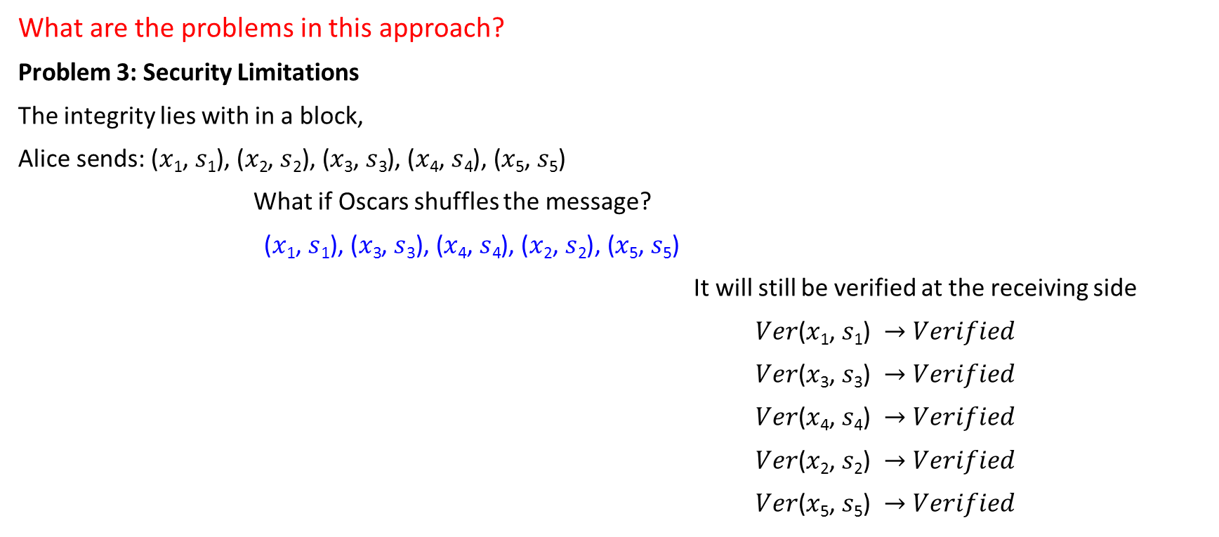
Issues
What are the problems in this approach?
Problem 3: Security Limitations
The integrity lies with in a block,
$\text{Alice} \text{sends}\text{: (}\text{x}\text{1}\text{, }\text{s}\text{1}\text{), (}\text{x}\text{2}\text{, }\text{s}\text{2}\text{), (}\text{x}\text{3}\text{, }\text{s}\text{3}\text{)}$, $\text{(}\text{x}\text{4}\text{, }\text{s}\text{4}\text{), (}\text{x}\text{5}\text{, }\text{s}\text{5}\text{)}$
What if Oscars shuffles the message?
$\text{(}\text{x}\text{1}\text{, }\text{s}\text{1}\text{), (}\text{x}\text{3}\text{, }\text{s}\text{3}\text{), (}\text{x}\text{4}\text{, }\text{s}\text{4}\text{)}$, $\text{(}\text{x}\text{2}\text{, }\text{s}\text{2}\text{), (}\text{x}\text{5}\text{, }\text{s}\text{5}\text{)}$
It will still be verified at the receiving side
$Ver\text{(}\text{x}\text{1}\text{, }\text{s}\text{1}\text{)} →Verified$
$Ver\text{(}\text{x}\text{3}\text{, }\text{s}\text{3}\text{) }→Verified$
$Ver\text{(}\text{x}\text{4}\text{, }\text{s}\text{4}\text{) }→Verified$
$Ver\text{(}\text{x}\text{2}\text{, }\text{s}\text{2}\text{) }→Verified$
$Ver\text{(}\text{x}\text{5}\text{, }\text{s}\text{5}\text{) }→Verified$

Slide 11
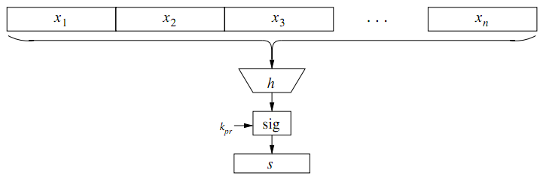
Issues
What are the problems in this approach?
Solution:
Use a Hash Function

Slide 12




Basic Protocol
Alice
$$z=h\left(x\right)$$
$${Ver}_{pub}=(z,s)$$
$$z′{= Sig}_{Kpub}^{−1}(s)$$
$$z^{′}=z$$
Bob
$$K_{pub}$$
$z=h\left(x\right)$
${s= Sig}_{Kpr}(z)$
$$(Kpub)$$
$$(x,s)$$
z is the finger print of x, it is also known as message digest

Slide 13
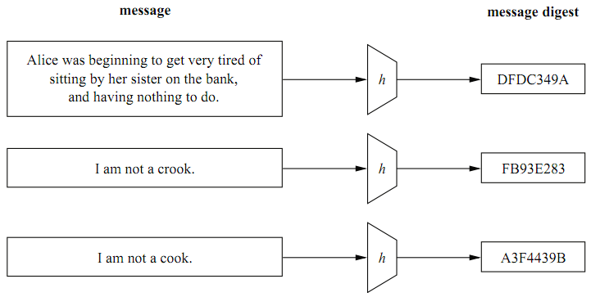
Properties of a Hash Function
Arbitrary length input.
Fixed length output.
It should be fast.

Slide 14
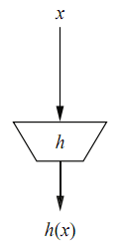
Properties of a Hash Function
Pre-Image Resistance or One-wayness.
It is a forward function. If we have a hash output, it will be impossible to compute the input

Slide 15
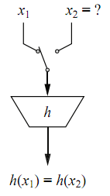
Properties of a Hash Function
2nd Pre-Image Resistance or Weak Collision Resistance.
Attacker should not be able to compute x2 with same HV.
z = HF (x1)
z = HF(x2)

Slide 16
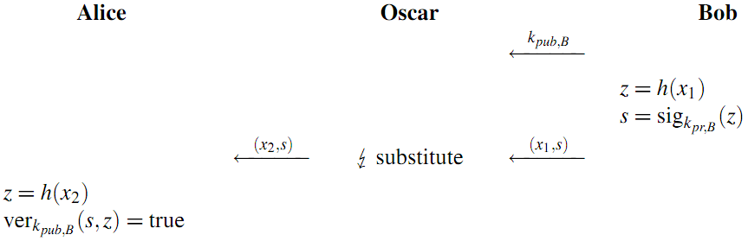
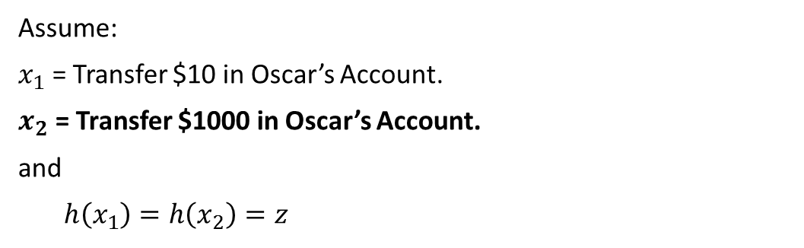
Attack
Assume:
$x_{1}$ = Transfer $10 in Oscar’s Account.
$x_{2}$ = Transfer $1000 in Oscar’s Account.
and
$h\left(x_{1}\right)=h\left(x_{2}\right)=z$

Slide 17

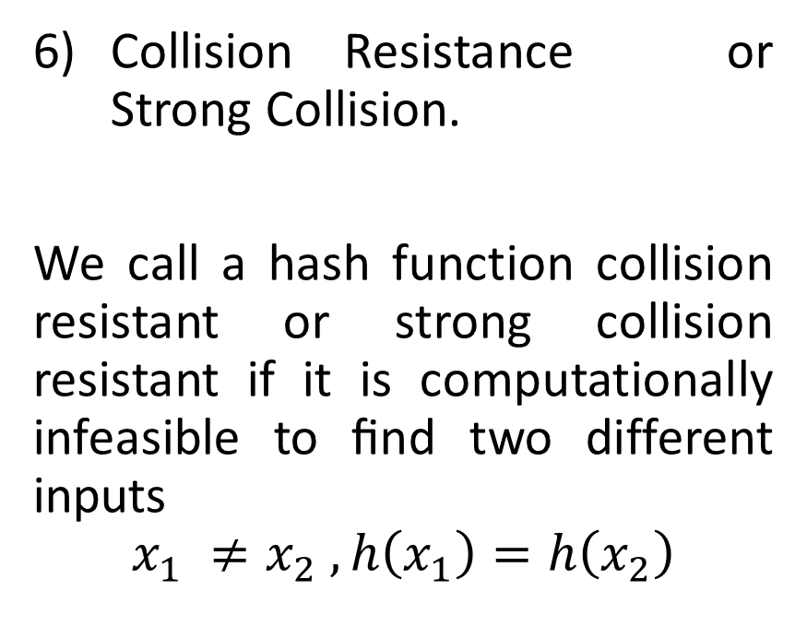
Properties of a Hash Function
Collision Resistance or Strong Collision.
We call a hash function collision resistant or strong collision resistant if it is computationally infeasible to ﬁnd two different inputs
$$x_{1} ≠x_{2} ,h\left(x_{1}\right)=h\left(x_{2}\right)$$

Slide 18
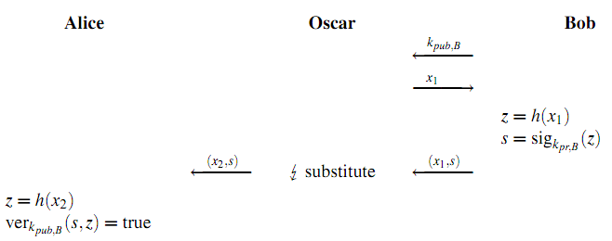
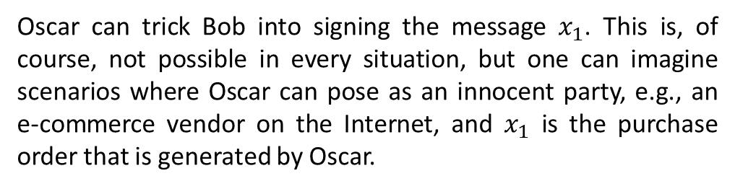
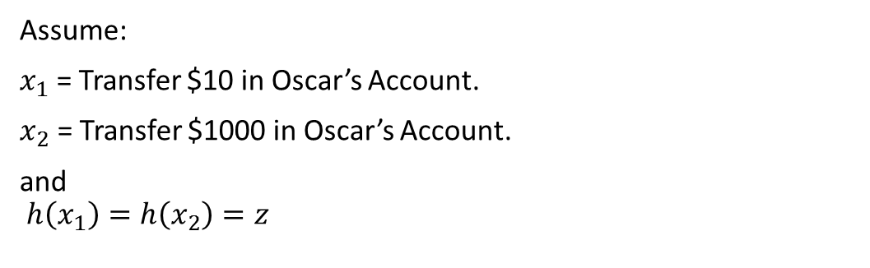
Attack
Assume:
$x_{1}$ = Transfer $10 in Oscar’s Account.
$x_{2}$ = Transfer $1000 in Oscar’s Account.
and
$$h\left(x_{1}\right)=h\left(x_{2}\right)=z$$
Oscar can trick Bob into signing the message $x_{1}$. This is, of course, not possible in every situation, but one can imagine scenarios where Oscar can pose as an innocent party, e.g., an e-commerce vendor on the Internet, and $x_{1}$ is the purchase order that is generated by Oscar.

Slide 19
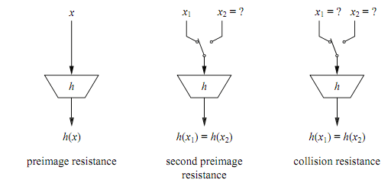
Properties of a Hash Function

Slide 20
Properties of a Hash Function
Can we create a Hash Function without collision?
No. All Hash Function must have collision.
│x │ >> │z │
. x
. z

Slide 21
Collision Attack and Birthday Paradox
2nd Pre-Image with Brute Force
Collision Resistance with Bday Paradox
h(x1)
h(x1)
h(x2)
h(x2)
h(x3)
h(x3)
h(x4)
h(x4)

Slide 22
